Slide 1

Lecture – 3.3 JAVA variables and Modifiers
Afsara Tasneem Misha
Lecturer
Department of CSE
Daffodil International University

Slide 2
Contents
Java variables
Java Modifiers

Slide 3
Variables in java

Slide 4
Variables in java
Variables
Local Variables
Instance Variables
Class/Static Variables

Slide 5
1. Local variables
Local variables are declared inside methods, constructors, or blocks.
Local variables are visible only within the declared method, constructor or block.
Access modifiers cannot be used for local variables.

Slide 6
2. Instance variables
Instance variables are declared in a class, but outside a method, constructor or any block.
Instance variables are created when an object is created with the use of the keyword 'new' and destroyed when the object is destroyed.
Access modifiers can be given for instance variables.
The instance variables are visible for all methods, constructors and block in the class.

Slide 7
3. Class/static variables
Class variables also known as static variables are declared with the static keyword in a class, but outside a method, constructor or a block.
Static variables are rarely used other than being declared as constants.
Visibility is similar to instance variables.
However, most static variables are declared public since they must be available for users of the class.

Slide 8
Key points
Local Variable
A variable that is declared inside the method
Instance Variable
A variable that is declared inside the class but outside the method.
It is not declared as static.
Static variable
Similar to instance variable but it is declared as static.

Slide 9
Example to understand the types of variables
Example - 1:
class A
{
int data=50; // instance variable
static int m=100; // static variable
void method()
{
int n=90; // local variable
}
}

Slide 10
Example - 2:
public class MyClass
{
int a = 50;
static int b = 100;
public void method1()
{
int n = 90;
System.out.println(n);
System.out.println(a);
System.out.println(b);
}
public void method2()
{
System.out.println(n);
System.out.println(a);
System.out.println(b);
}
public static void main(String[] args)
{
MyClass ob = new MyClass ();
ob.method1 ();
ob. method2 ();
}
}

Slide 11
Example - 3:
public static void sum()
{
NewClass obj = new NewClass();
System.out.println(obj.max);
System.out.println(var);
//System.out.println(a+b);
}
}
public class NewClass {
int max = 100; //instance variable
static int var = 50; // static variable
public static void main(String[] args)
{
int a = 10, b = 20; // local variable
System.out.println(a+b);
NewClass obj = new NewClass();
System.out.println(obj.max);
System.out.println(var);
sum();
}

Slide 12
Modifiers in java

Slide 13
Modifiers
Modifiers are keywords that you add to those definitions to change their meanings.
There are two types of modifiers in java:
1. Access modifiers
2. Non-access modifiers

Slide 14
1. Access Modifiers

Slide 15
1. Access Modifiers in java
The access modifiers in java specifies accessibility (scope) of a data member, method, constructor or class.
There are 4 types of java access modifiers:
private
default
protected
public

Slide 16
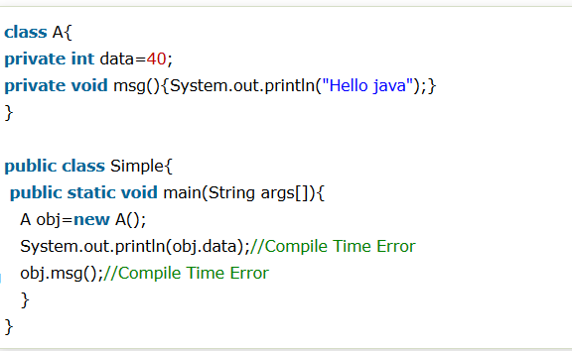
1) private access modifier
The private access modifier is accessible only within the class.
Simple example of private access modifier
In this example, we have created two classes A and Simple. A class contains private data member and private method. We are accessing these private members from outside the class, so there is compile time error.

Slide 17
private access modifier

Slide 18
2) default access modifier
If you don't use any modifier, it is treated as default by default.
The default modifier is accessible only within package.

Slide 19
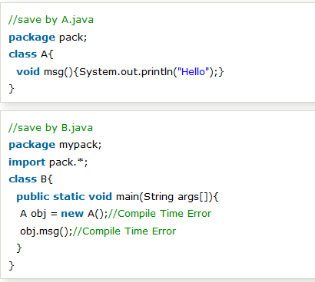
Example of default access modifier In this example, we have created two packages pack and mypack. We are accessing the A class from outside its package, since A class is not public, so it cannot be accessed from outside the package.
In the above example, the scope of class A and its method msg() is default so it cannot be accessed from outside the package.

Slide 20
default access modifier

Slide 21
3) protected access modifier
The protected access modifier is accessible within package and outside the package but through inheritance only.
The protected access modifier can be applied on the data member, method and constructor. It can't be applied on the class.

Slide 22
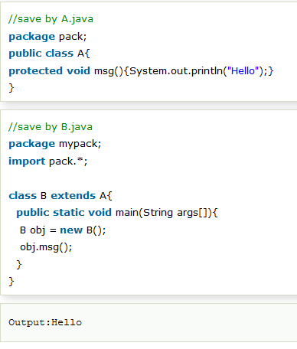
Example of protected access modifier
In this example, we have created the two packages pack and mypack. The A class of pack package is public, so can be accessed from outside the package. But msg method of this package is declared as protected, so it can be accessed from outside the class only through inheritance.

Slide 23
protected access modifier

Slide 24
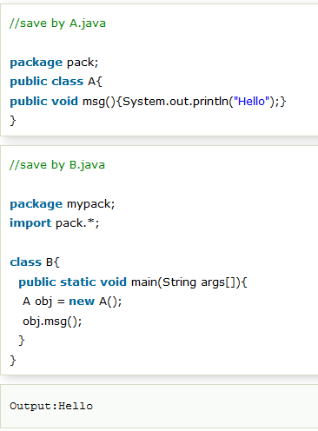
4) public access modifier
The public access modifier is accessible everywhere.
It has the widest scope among all other modifiers.
Example of public access modifier

Slide 25
public access modifier

Slide 26
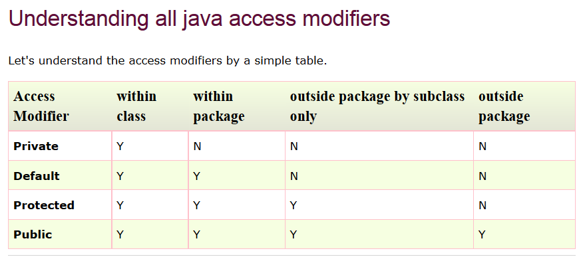

Slide 27
2. Non-Access Modifiers

Slide 28
2. Non-Access Modifiers
static modifier
for creating class methods and variables
final modifier
for finalizing the implementations of classes, methods, and variables.
abstract modifiers
for creating abstract classes and methods.
synchronized and volatile modifiers
which are used for threads.

Slide 29

Thank you!

